Slide 1
The Prince from the High Spire
An exploration of the world i’m writing
-Lupus

Slide 2
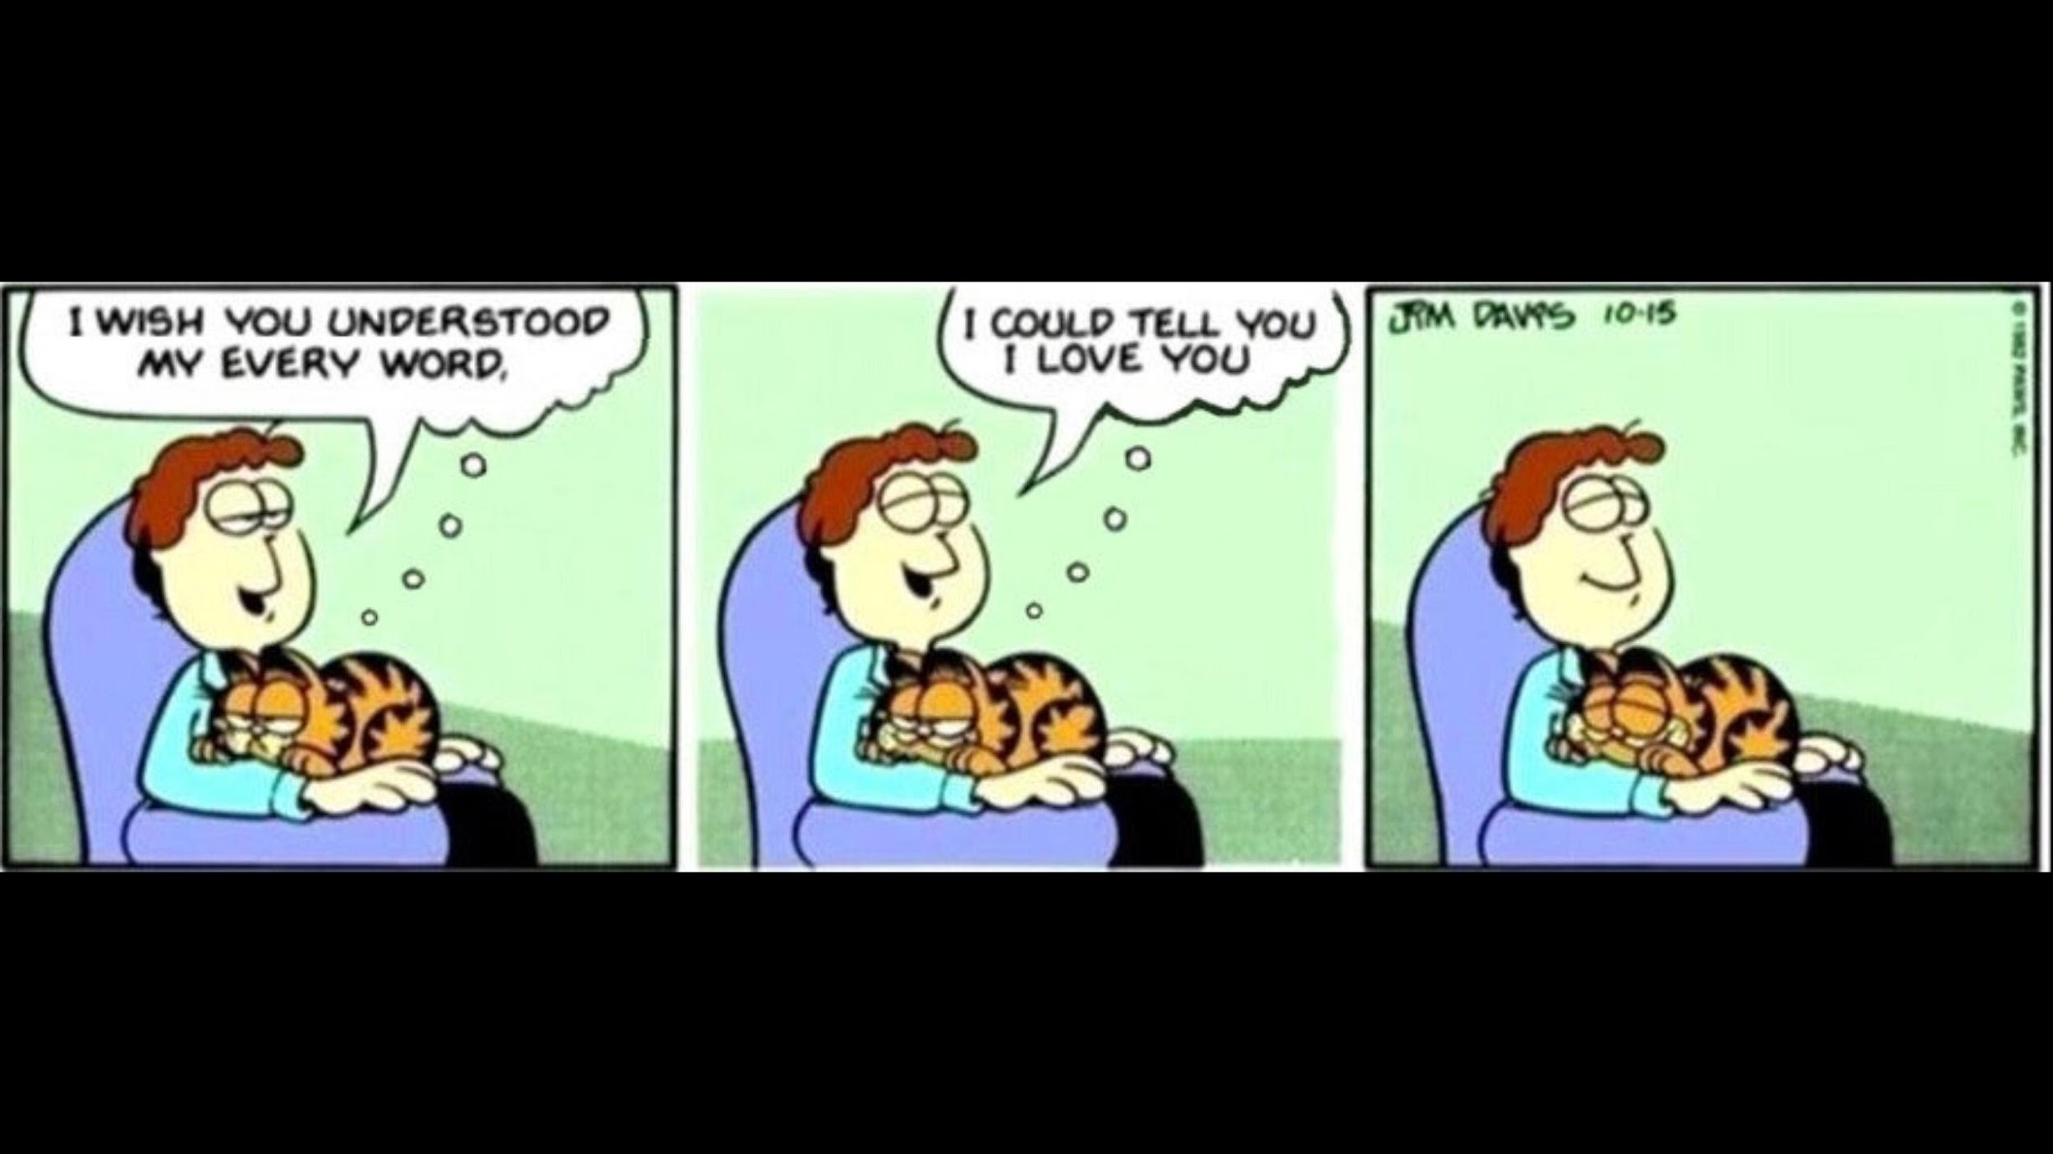
What is the Prince from the High Spire?
A

Slide 3

The World
A combination of ideas
Middle ages city state kingdom
Light punk
Sectioned meritocracy
3 sectioned city
Spire of Earth - The body
Spire of Water - The spirit
Spire of Air - The mind (logos)
A partial panopticon

Slide 4
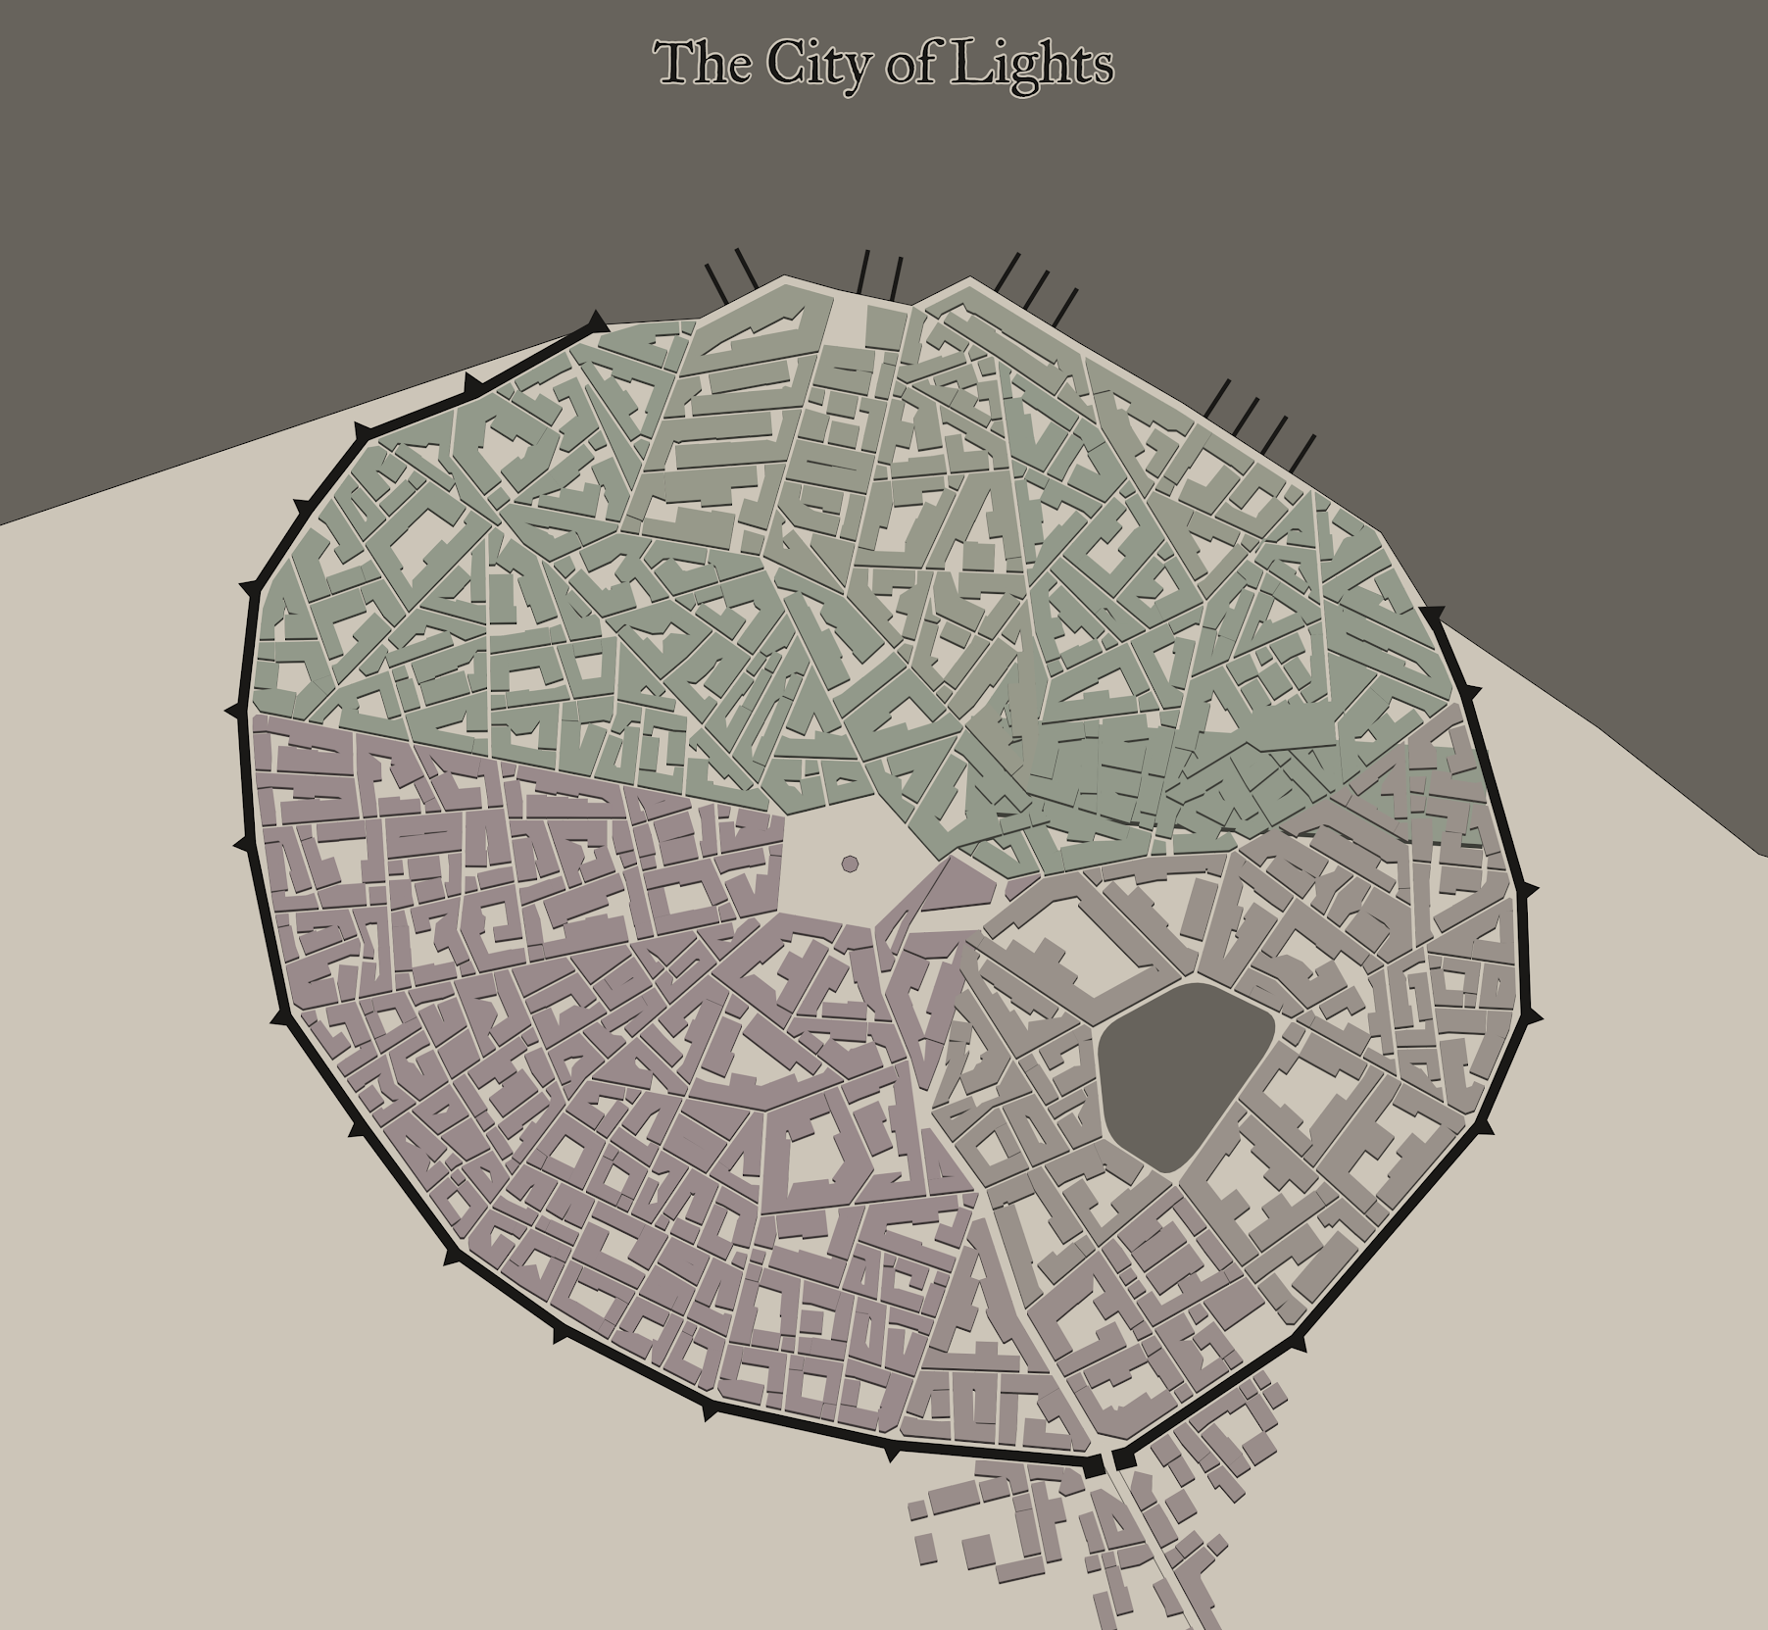
The Kingom of Lights
The Spire of Sea
The Spires
Sky
Sea
Earth
High Spire
Corresponding district focuses
Sky Mind, logic and calculations as well as science.
Sea Art, the human experience, master-craftsmanship
Earth Practicality, honing of the body, physical labor and work, martial prowess.
The High Spire
The Spire of Sky
The Spire of Earth

Slide 5
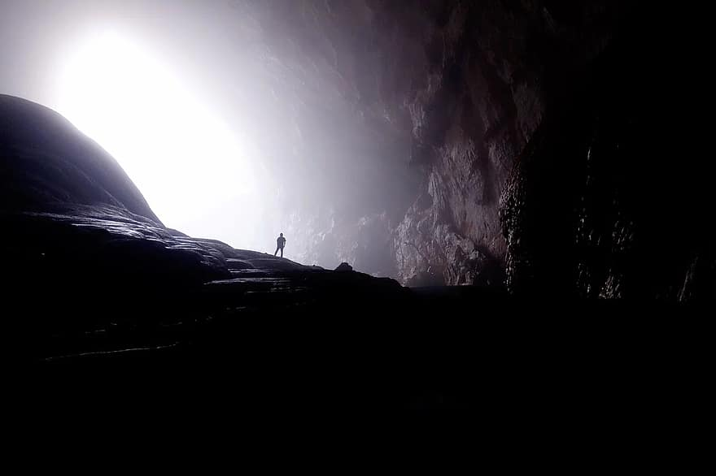
The crystal lenses
Used to transmit images and as focuses to view stuff from a distance.
The spire of air uses lenses as a complex system of storing information and acting as logical computation devices.
Large ones for communication and observation placed in each spire, as well as the crystal libraries within the high and sky spires.
Mined underneath the mountain in a large cave system

Slide 6
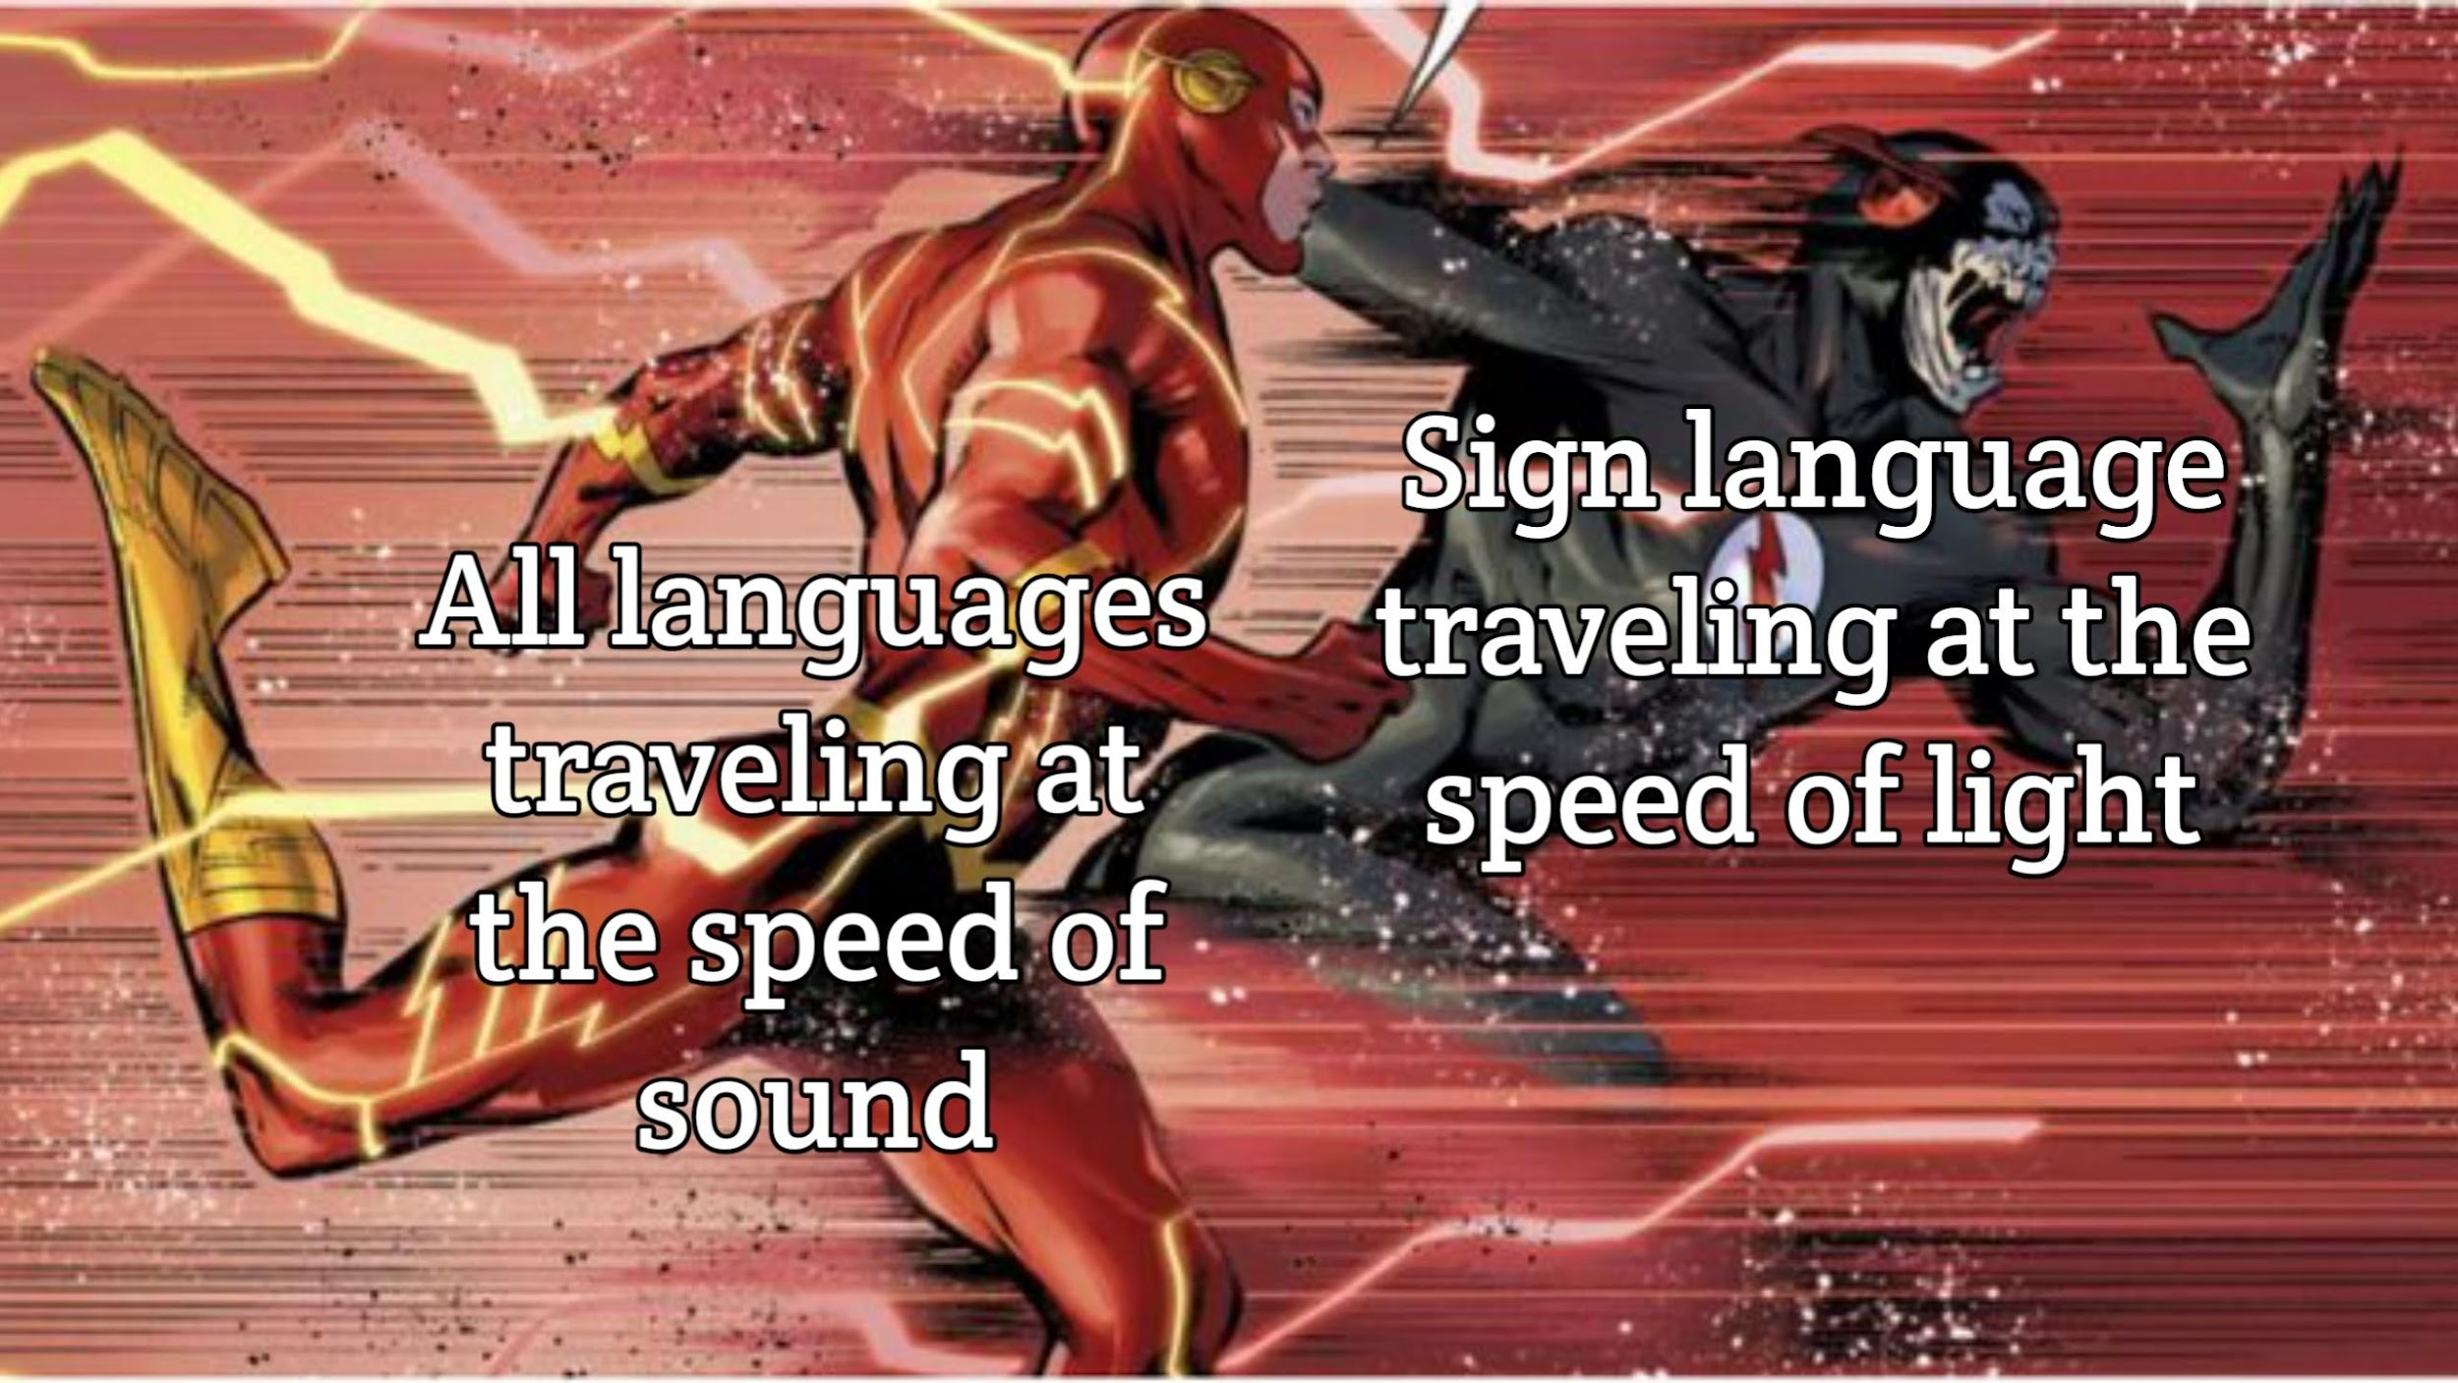
Lenses as a form of communication and surveillance

Slide 7
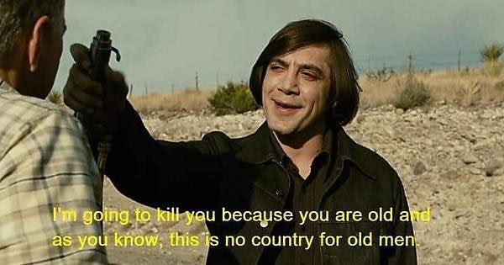
The kingdom as a meritocracy
Each spire has its own ideals
Progress in your spire heightens your standing
You are allowed to move around to other spires but most do not
Those of each spire of the highest prowess and merit are called the high watchers.
The high watchers are required a level of understanding of the other spires

Slide 8
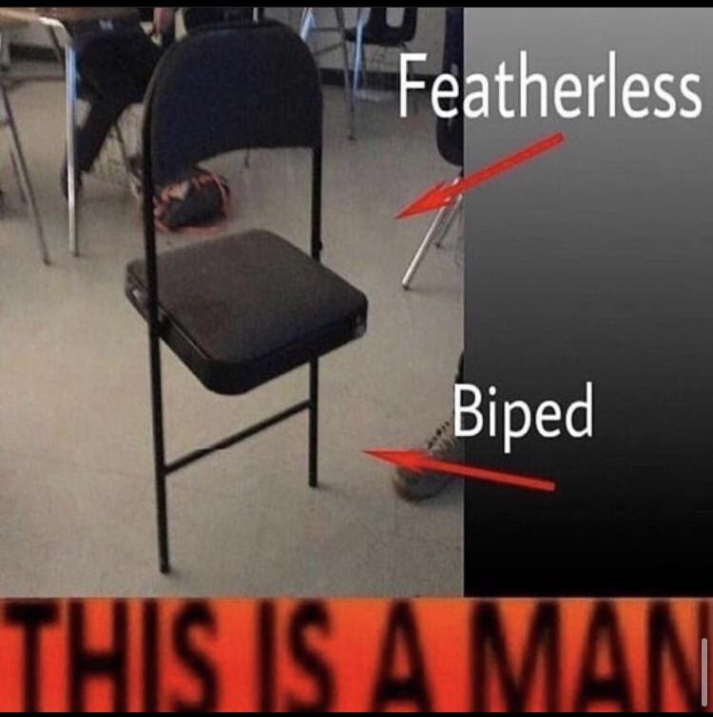
The High spire
Palace where all 3 spires meet.
The prince is tutored by the High Watchers
The king is supposed to be a perfect union and understanding of all 3 ideals.

Slide 9
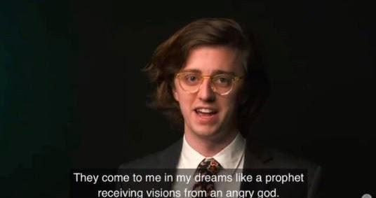
The focus of my story
The prince
Tensions within the City and the prince
The exploration of each spire and their place in the city
The princes relationships to the world and people as he grows.
Hopefully individuation
Humans as flawed people
Presenting the world as it feels to the prince.
Also currently only has 8 pages written.

Slide 10

Flattery intermission
We choose one person in VC at random (can use die rolls) and cover them in genuine compliments

Slide 11

Reading of an excerpt.
One thing that had kept me back from writing was dialogue, because of this i made sure to write some.

Slide 12
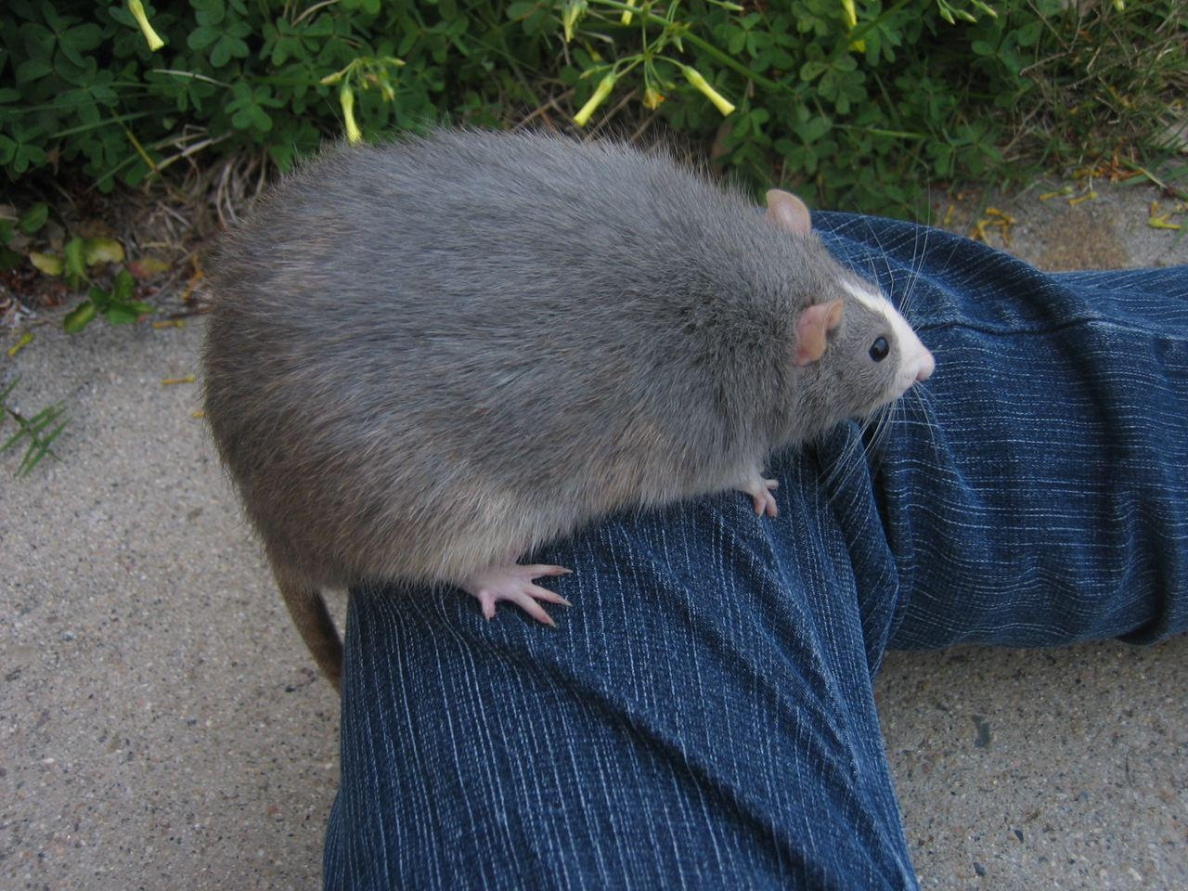
Small excerpt (yarex recommendation)
WELCOME!!! GABE’S GF ♥♥♥♥♥
The sounds of the city echoed below,
it passed to him, remained in the flow.
To one from another, from the chorus unmeld.
Indistinct chatter,
this he beheld.
A sister and brother,
this he beheld.
The core of their matter,
this he beheld.
From one to another, sensation unquelled.
Sounds of life from above and below,
talking and laughing and more sounds in tow.

Slide 13

Thank you for listening.

